Slide 1
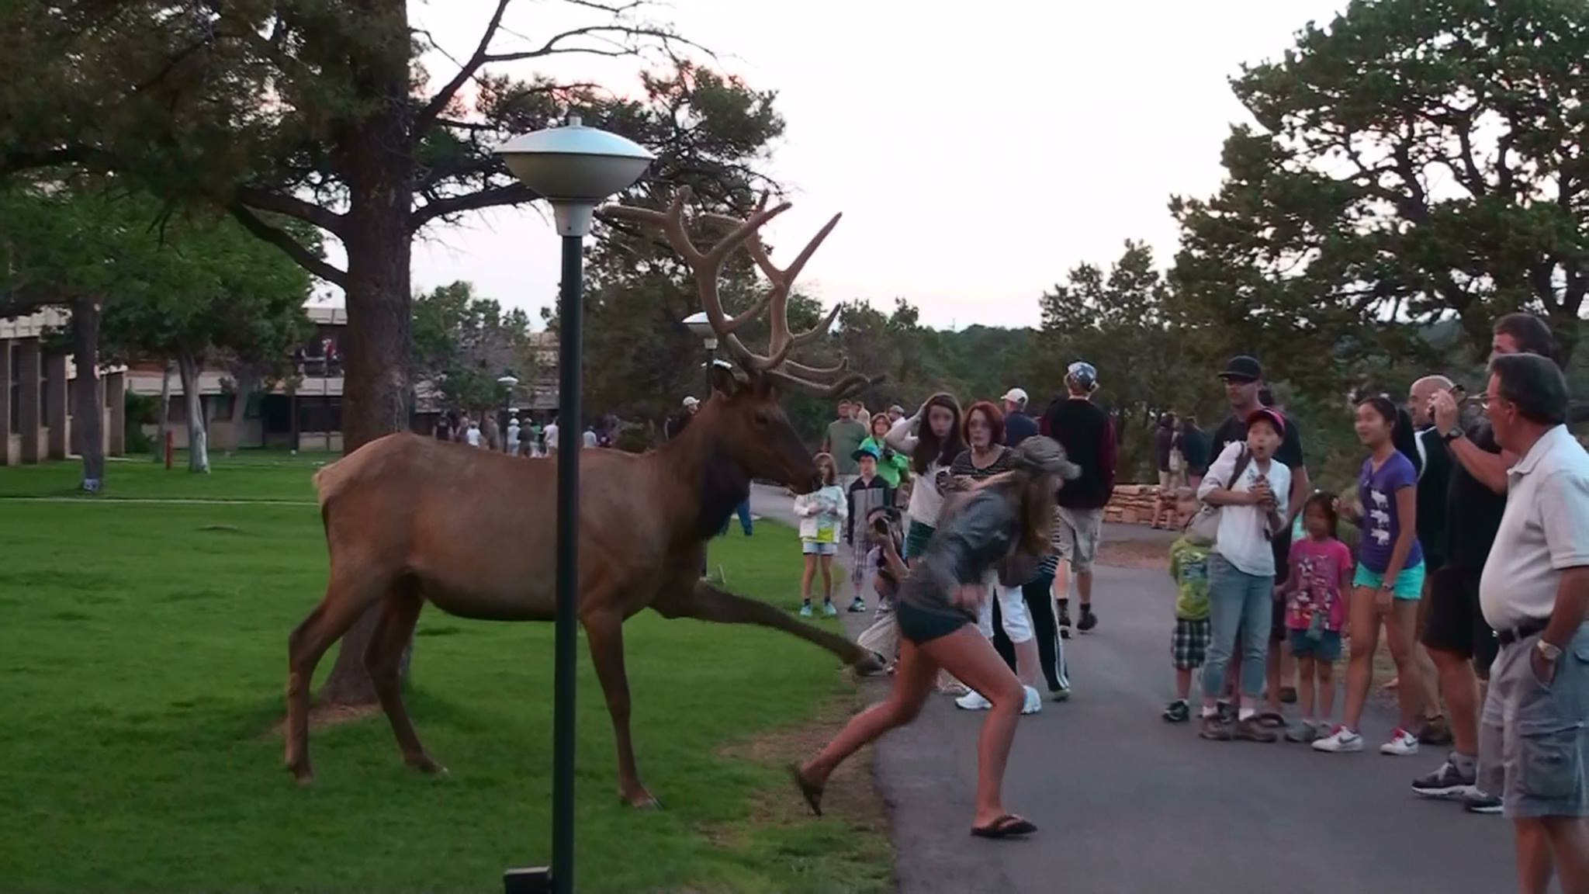
Chicago human-wildlife conflict modeling

Slide 2

The paper that spawned this idea…

Slide 3
What’s cool about the model…
inputs
Presence only data (e.g., community science data)
Rigorous detection / non-detection data
Spatial / temporal covariates

Slide 4
What’s cool about the model…
inputs
outputs
Presence only data (e.g., community science data)
Species occupancy across landscape
Rigorous detection / non-detection data
Spatial / temporal covariates

Slide 5
What’s cool about the model…
inputs
outputs
Presence only data (e.g., community science data)
Species occupancy across landscape
The bias from presence only data
Rigorous detection / non-detection data
Spatial / temporal covariates

Slide 6
What’s cool about the model…
inputs
outputs
Presence only data (e.g., community science data)
Species occupancy across landscape
The bias from presence only data
Rigorous detection / non-detection data
Pr(detection) from detection / non-detection data
Spatial / temporal covariates

Slide 7
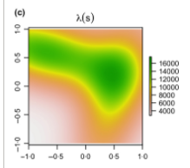
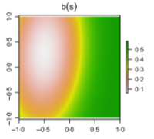
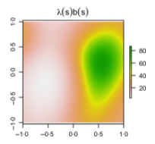
What does this presence only bias look like?
Species occupancy
Presence-only bias
What your observed presence-only data will look like

Slide 8
But what if that bias is not actually a nuisance parameter, what if it could estimate something useful?
Species occupancy
Probability of human-wildlife conflict
Where human wildlife conflict occurs

Slide 9


What if we combined 311 wildlife complaint data with our camera trapping data?
Presence-only data
Detection / non-detection data

Slide 10

Of course, I had to over-complicate things…
The standard integrated model is for a single season, it does not account for spatio-temporal correlation.
Other canned techniques I typically use with occupancy data are not as applicable

Slide 11
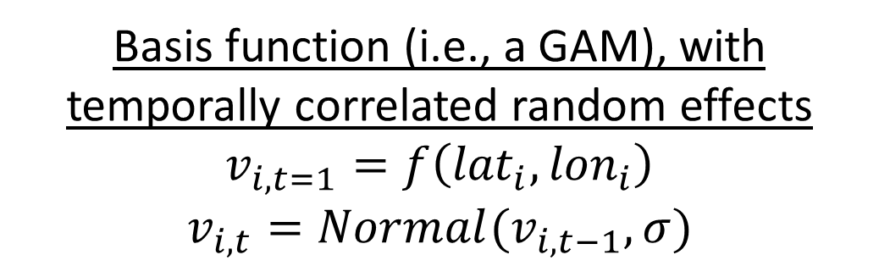
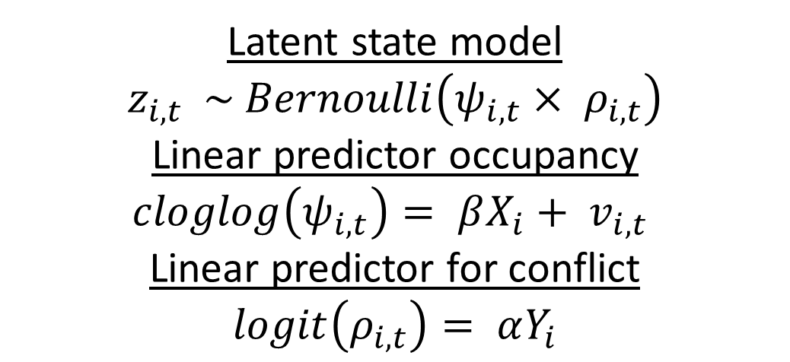
Latent state model
$$z_{i,t} \sim Bernoulli\left(ψ_{i,t}{× ρ}_{i,t}\right)$$
Linear predictor occupancy
$$cloglog\left(ψ_{i,t}\right)= βX_{i}+ v_{i,t}$$
Linear predictor for conflict
$$logit\left(ρ_{i,t}\right)= αY_{i}$$
Basis function (i.e., a GAM), with temporally correlated random effects
$$v_{i,t=1}=f\left({lat}_{i}, {lon}_{i}\right)$$
$$v_{i,t}=Normal(v_{i,t−1}, σ)$$

Slide 12
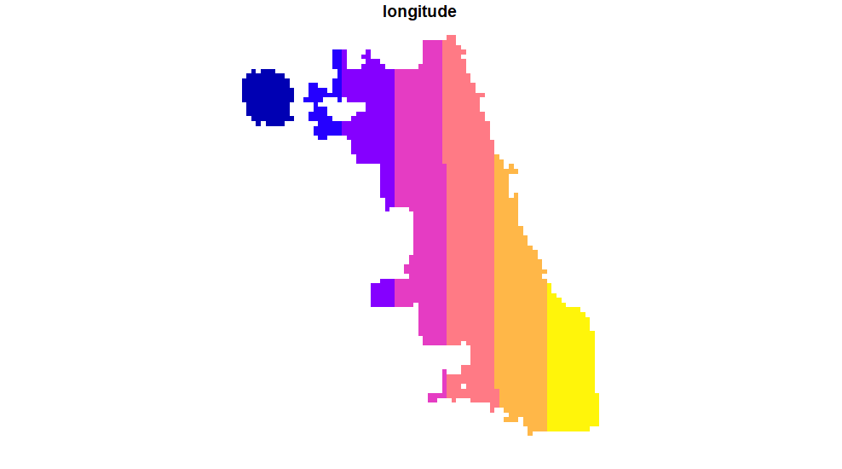
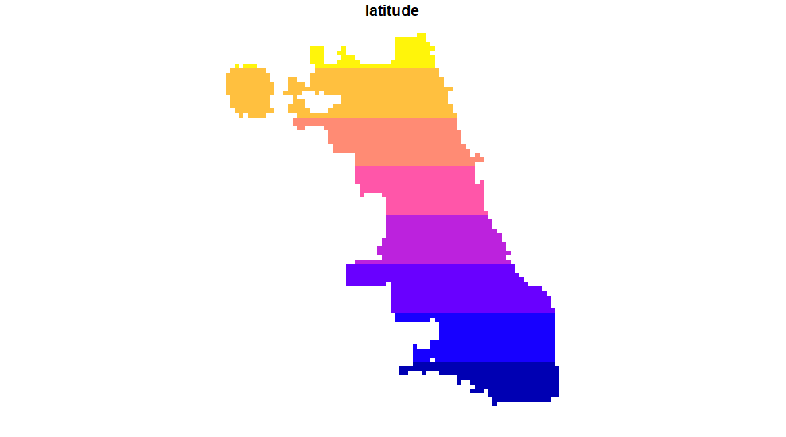

Basis functions are smoothing terms
$$f\left({lat}_{i}, {lon}_{i}\right)$$

Slide 13
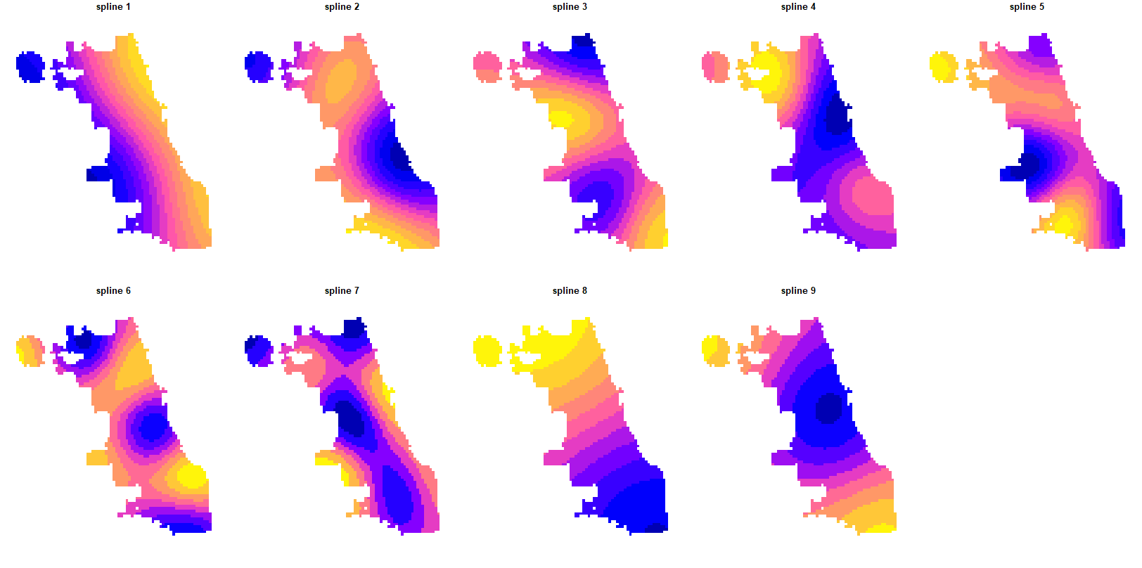
That converts covariates into a suite of polynomials, or splines

Slide 14

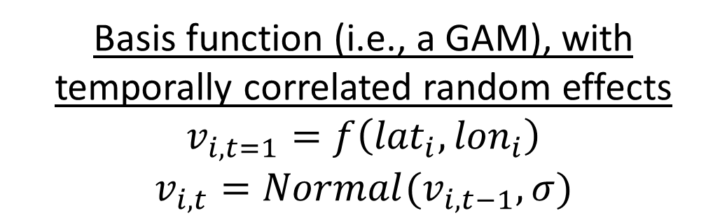
And then we use those splines as covariates within the model, which accounts for spatial autocorrelation and allows that correlation to evolve through time
Basis function (i.e., a GAM), with temporally correlated random effects
$$v_{i,t=1}=f\left({lat}_{i}, {lon}_{i}\right)$$
$$v_{i,t}=Normal(v_{i,t−1}, σ)$$
$$f\left({lat}_{i}, {lon}_{i}\right)= θ{Splines}_{i}$$

Slide 15
One unique issue related to the model
You cannot have identical linear predictors for the Pr(occupancy) and the Pr(conflict) parts of the model.
You need one unique covariate in each linear predictor for parameters to be identifiable

Slide 16
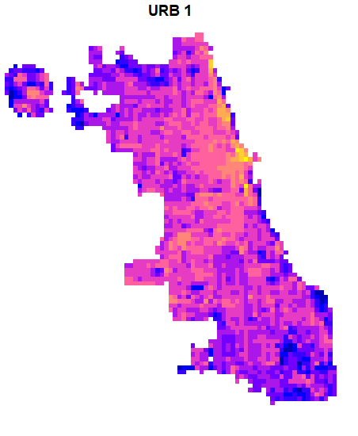
Other covariates: Urbanization PCA 1 (only on occupancy)
Lighter values indicate areas with higher impervious cover & housing density
Darker values indicates areas with greater tree cover

Slide 17
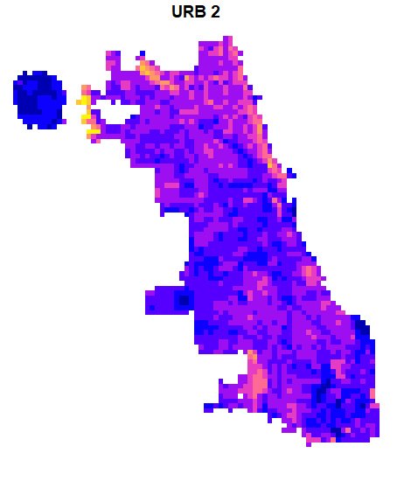
Other covariates: Urbanization PCA 2 (only on conflict)
Lighter values indicate areas with higher tree cover & housing density
Darker values indicates areas with more bare ground (e.g., impervious cover or grass cover)

Slide 18
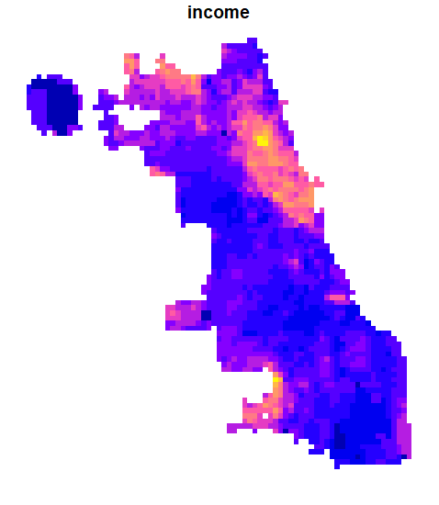
Other covariates: income (both)
Lighter colors = higher income
Darker colors = lower income

Slide 19
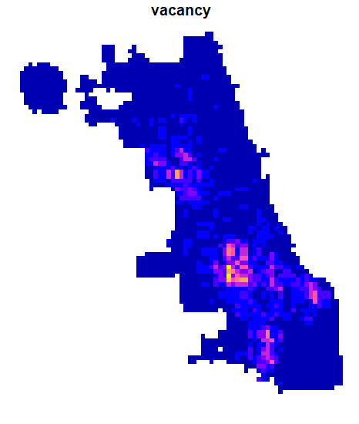
Other covariates: vacancy (both)
Lighter colors = more vacant building reports
Darker colors = vacant building reports

Slide 20
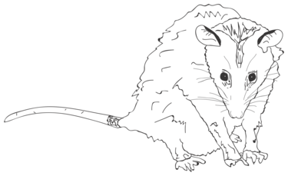
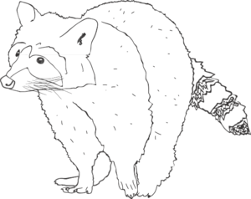
The species

Slide 21
The data
43 camera trap sites within Chicago, data from 2011 – 2013 (12 sampling periods)
Complaint data:
Coyote: ~ 236 complaints per sampling period (N = 2839)
Opossum: ~ 134 complaints per sampling period (N = 1634)
Raccoon: ~216 complaints per sampling period (N = 2592)

Slide 22
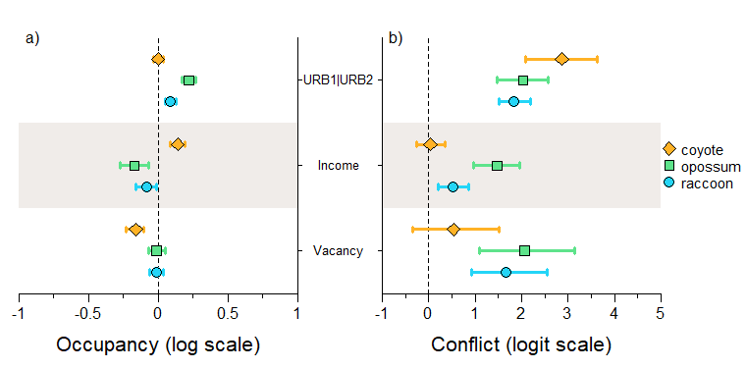
Results

Slide 23
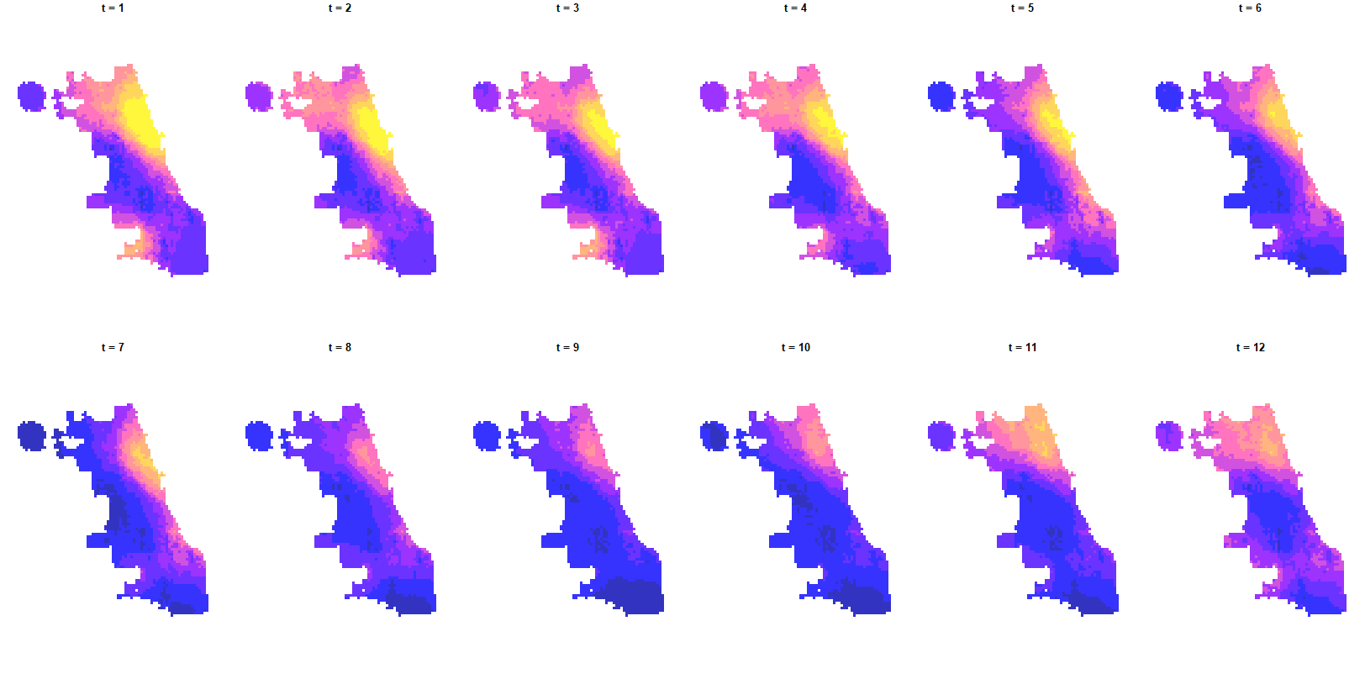
Coyote occupancy

Slide 24
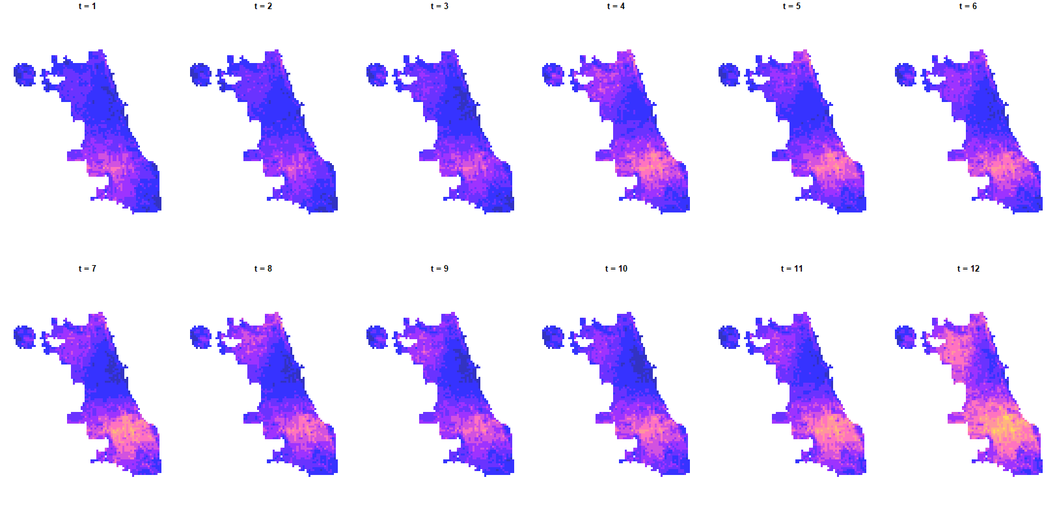
opossum occupancy

Slide 25
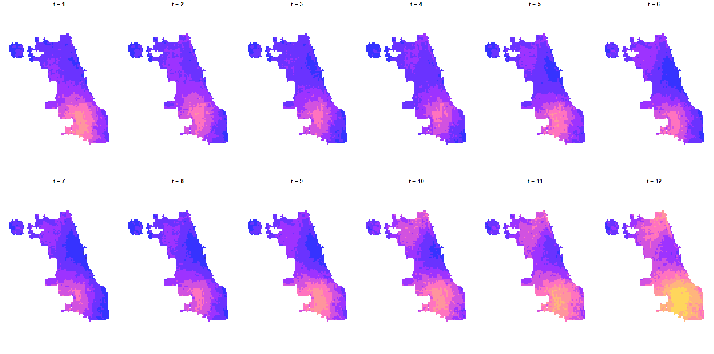
raccoon occupancy

Slide 26
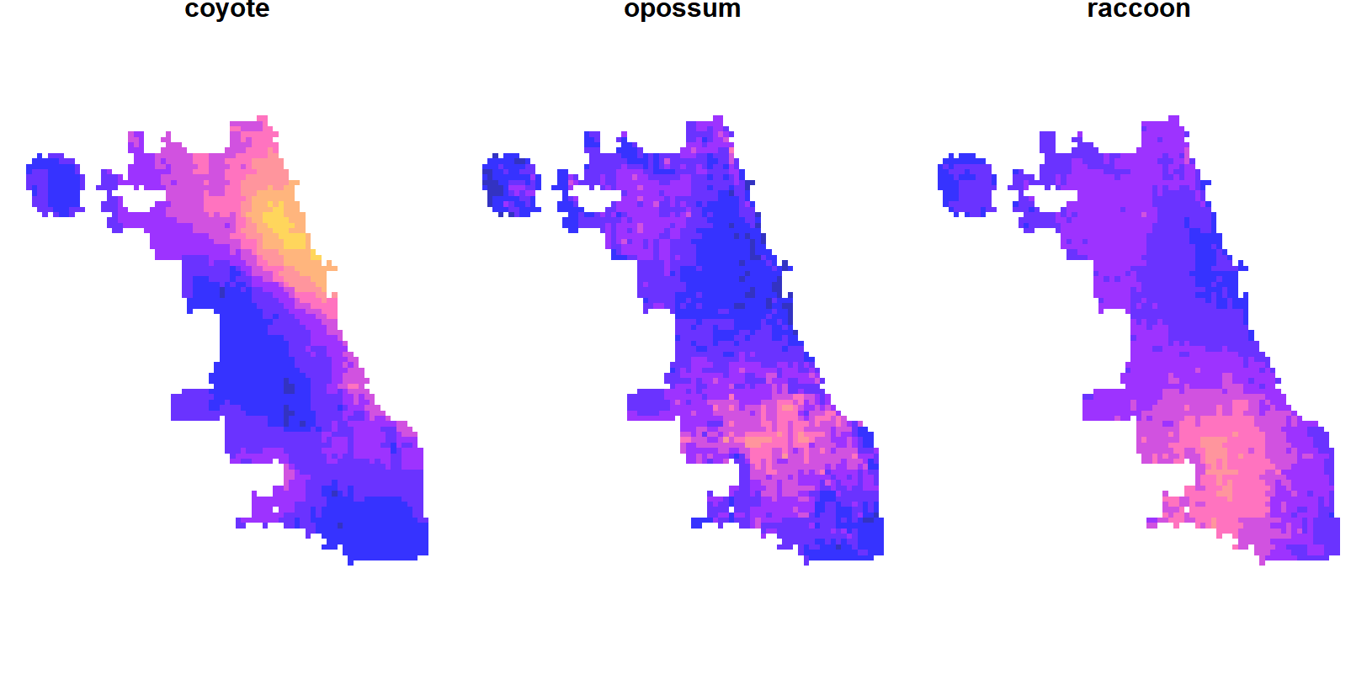
Average occupancy across sampling periods

Slide 27
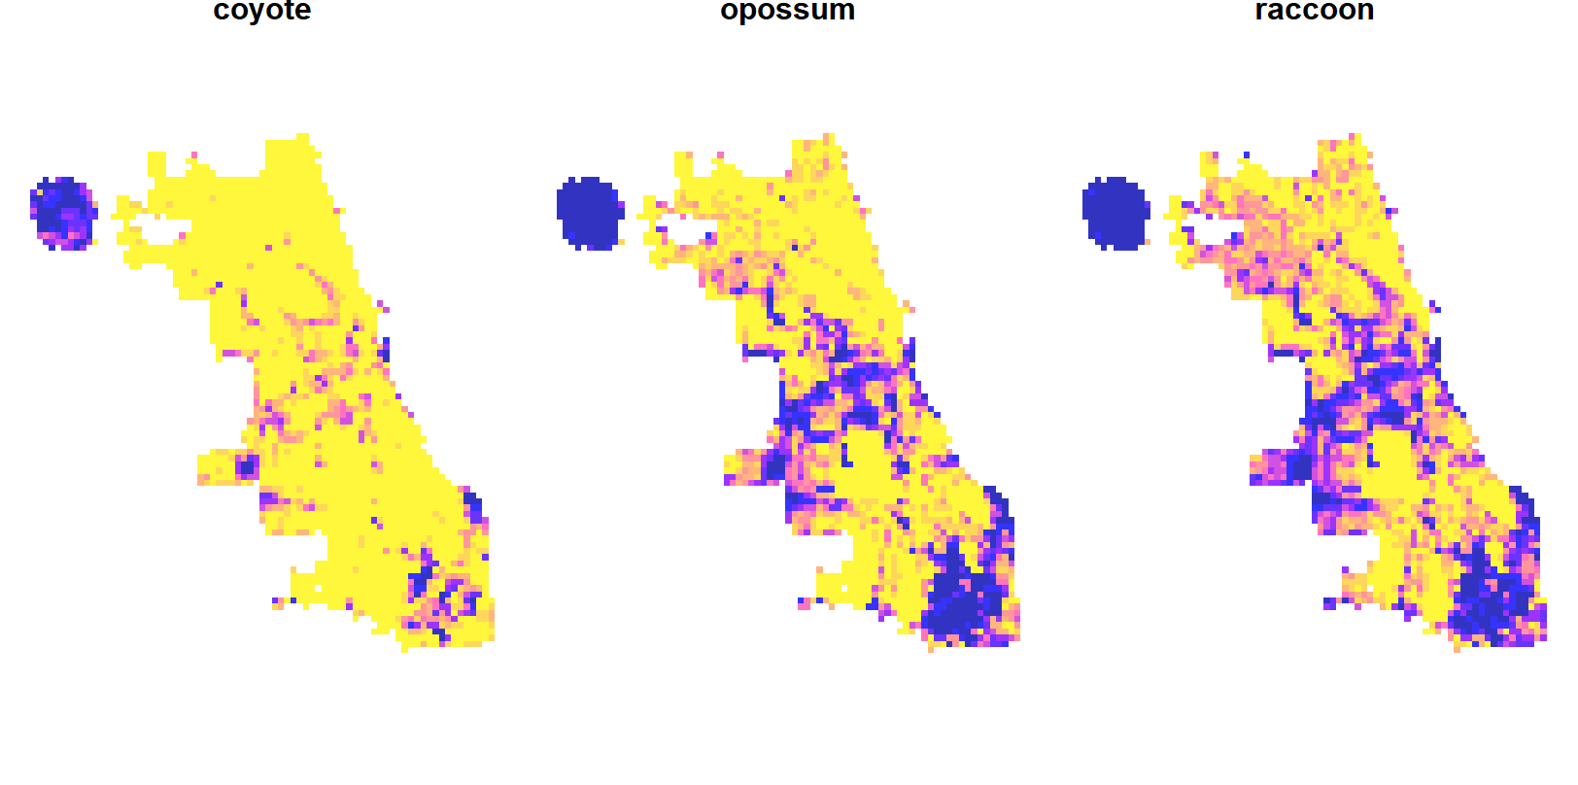
Pr(conflict)

Slide 28
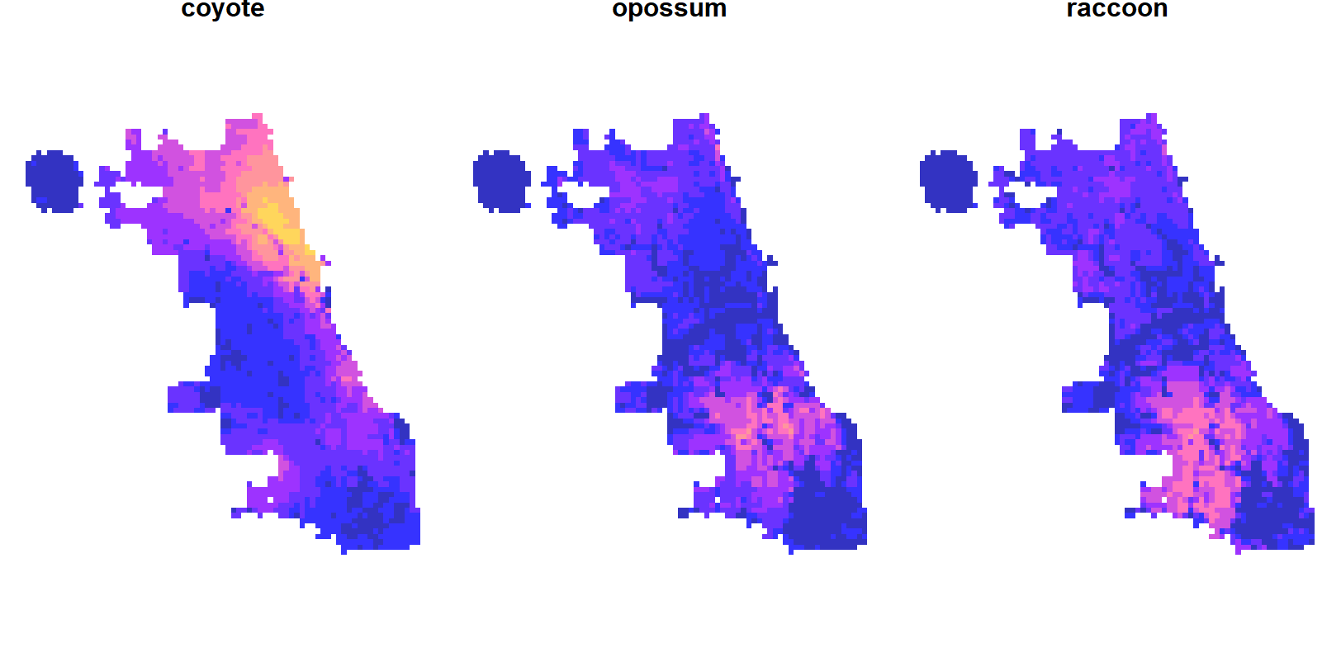
Pr(occupancy) * Pr(conflict)

Slide 29
Coyote looks quite similar
occupancy
Occupancy * conflict

Slide 30
Opossum is a little different
occupancy
Occupancy * conflict

Slide 31
And raccoon is a little different as well
occupancy
Occupancy * conflict

Slide 32
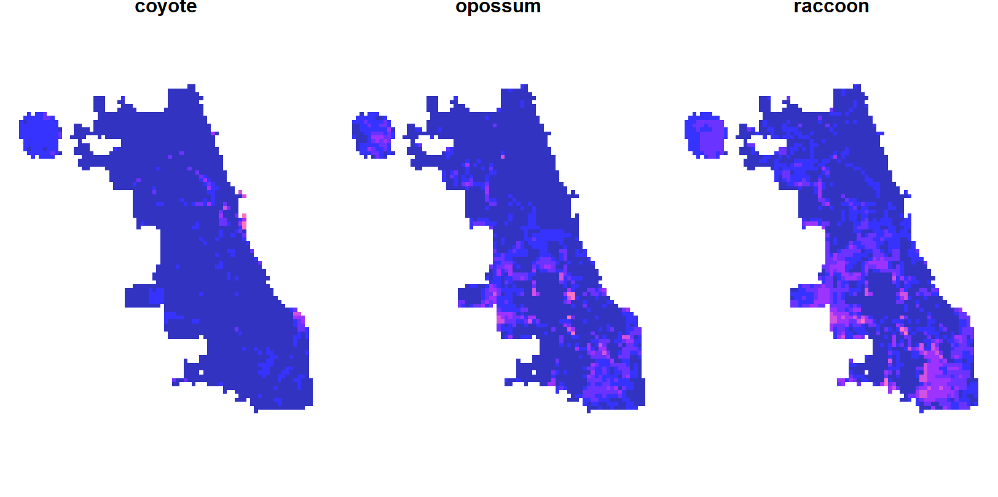
But overall, it’s not too different: Pr(occupancy) * (1 – Pr(conflict))

Slide 33
Interpretation?
People like to report coyote if they see them, and though these reports may come more from forested areas w/ houses, it essentially tracks their occupancy. They get into conflict according to their distribution, which is predominately on the north side of the city.
Opossum and raccoon are different, there is the middle of the city (sanitary & ship canal?) where they occupy but are often not reported. There are also patches within their distribution where they have relatively low conflict. Conflict

Slide 34
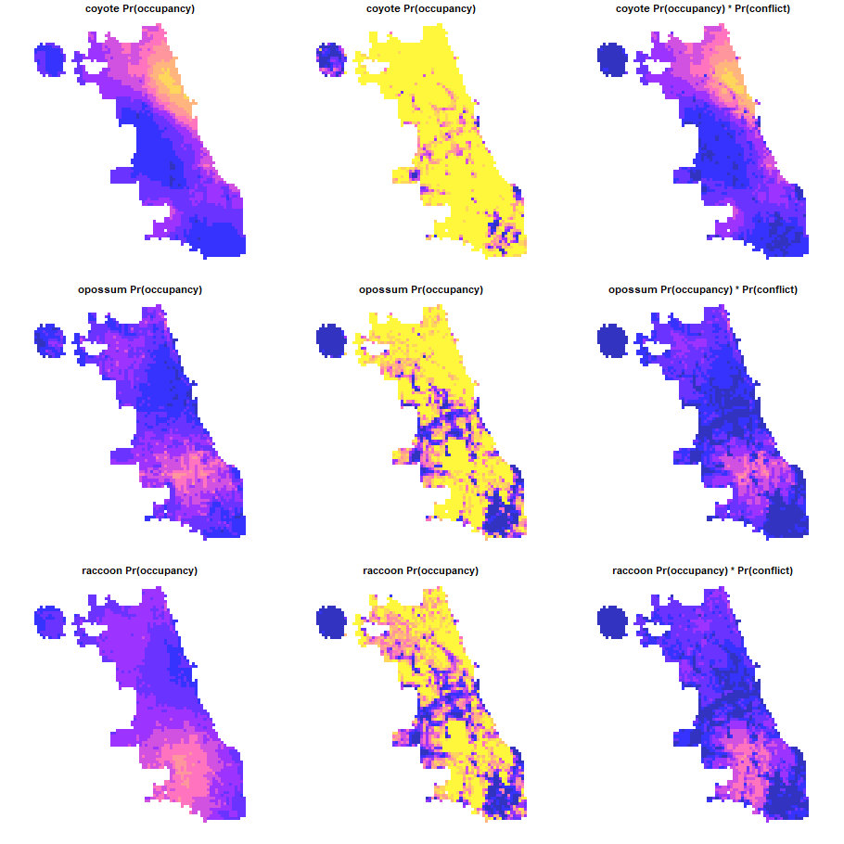
Any other figures?

